Slide 1
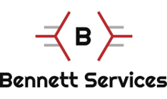
Build Smarter with AI: Creating SDS2 Parametrics and Applications Using the .NET API
Jason Bondioli - Bennett Services, LLC
Notes:
Thanks to:
Allplan/moderator and all the amazing staff and users group who puts this opportunity together.
You – desire to network and learn is admirable and should be recognized – self applause.

Slide 2
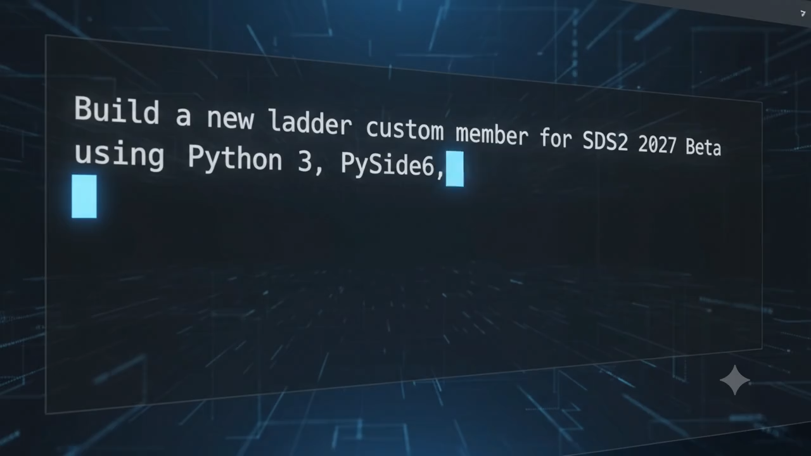
Notes:
We’re in a new era, and the things we’re going to talk about today don’t scratch the surface – but it’s relevant to what we do.
Kurt Apted presentation from a couple of years ago (showing his RFI tool) revitalized my interest in building parametrics and other tools.
Now I can build better tools in a fraction of the time without beating my head against the wall over stupid syntax mistakes or order of operation follies.
Outline:
Tools available
Prompting
Agentic Coding Assistant demo
Then:
I’m going to show you a few tools I’ve made, with some tips and tricks on how to do it with NO MANUAL CODING – however, it IS beneficial to learn the basics of Python to be more efficient. The good news is using this workflow can help you do that.
Finally: Q&A

Slide 3
Why am I here?
I am not an expert.
Sharing what I’ve learned.
Build a community of creators.
Eventually add to the available tools available to SDS2 user community.
Notes:
I AM NOT A PROGRAMMER
I understand the fundamentals of python, and can roughly understand some of the code, but I am not flawless with syntax, I don’t know what I don’t know, and using AI to help develop these tools has helped build my knowledge base.
The SDS2 community has had a long standing tradition of sharing knowledge with each other. Every year I come to this event, spend time on the various forums, and interact with other users I find myself overwhelmed with the generosity of all of us. While someday I do hope to develop some tools worthy of a small fee (these things still take a considerable amount of time to develop) the reason we are here today is for me to give back and share some of what I’ve learned over the last couple years so that others can be inspired to develop their own tools and hopefully share them with the community.

Slide 4
What’s the plan?
Quick slideshow
Plugin setup & prompting demonstration
Show and tell of tools built using AI
Q&A
Notes:
I AM NOT A PROGRAMMER
I understand the fundamentals of python, and can roughly understand some of the code, but I am not flawless with syntax, I don’t know what I don’t know, and using AI to help develop these tools has helped build my knowledge base.
The SDS2 community has had a long standing tradition of sharing knowledge with each other. Every year I come to this event, spend time on the various forums, and interact with other users I find myself overwhelmed with the generosity of all of us. While someday I do hope to develop some tools worthy of a small fee (these things still take a considerable amount of time to develop) the reason we are here today is for me to give back and share some of what I’ve learned over the last couple years so that others can be inspired to develop their own tools and hopefully share them with the community.

Slide 5
Why am I not here to do?
Discuss the political implications surrounding AI
Discuss the environmental impacts of AI data centers
Discuss the escape of AI agents heard in the news
Discuss the perceived threat of AI to our jobs
Notes:
Quick slide, maybe state your stance and move on.

Slide 6
Why should I use AI with SDS2?
Build tools the way YOU want.
Customize existing tools for specific situations.
Extract meaningful data cleanly.
Spend an hour today to save hours next week.
Learn a new skill!
Notes:
Ever be using SDS2 and think to your self “silly programmer, why the heck would they do it that way?” The people working in the background to make this relatively complex software work aren’t dumb, but like us they don’t know what they don’t know.
So why don’t they ask us? They do. (Impressed with Beta feedback loop) Have you ever asked a group of detailers how they would prefer to do something? Ask a group of 5 and you’ll get 10 unique ways it should de done.
Add to this that simple geographic location can change how things are done. Much like America is a social melting pot and a significant portion of our workforce is rooted in tradition, and on the job training, engineers are no different. In some locales hanging brick support frames are common place, some detailers have never heard of such nonsense.
Instead, I’m advocating to use the tools available to us today to build the tools you need yourself. If you’re waiting for Allplan to do it, you might be waiting a long time.

Slide 7
Useful terminology
Python
Libraries (PyQT (or PySide), Tkinter, pandas, pymupdf(fitz), PyVista, etc.
JSON
Function
Class
Notes:
Python – programming language, easy to read, plain English
Libraries – pre-written bundles of code that you can plug into your project (create dialogs, manage databases, create PDF’s)
JSON – (JavaScript Object Notation) organizes information in pairs and stored in a way that is easy for humans and computers to read.
Function – a reusable block of code for one specific task. Write the instructions once, give it a name, and then “call” it throughout your code to use it (keeps code clean and reduces repetitiveness).
Class – A blueprint or template in code form. Contains variables (or attributes) which define the object you are trying to create and functions (or methods – functions built inside a class) which again, instructs the code how to accomplish a specific task.

Slide 8
Parametric, Component, Custom Member – what’s the difference?
Parametric: One and done. Do it (wrong), delete it, do it again, but better. GREAT for extracting information!
Component: Add features to member(s) – Editable!
Custom Member: Build a better mousetrap. Create better UI’s, better functionality, do parametric things but make them editable!

Slide 9
Develop a plan
What is the end goal – pie in the sky dream.
How do we break it down into smaller steps.
What are things we can give in on for Version 1.0
Develop a prompt(s)
Notes:
Explain how to brainstorm an idea, don’t stop at what you need today, but what might you need a year from now, what might others need/want.
Strategize a plan to start. Small steps.
What can we cross off the brainstorm list to get a working version
Explain how to prompt.

Slide 10
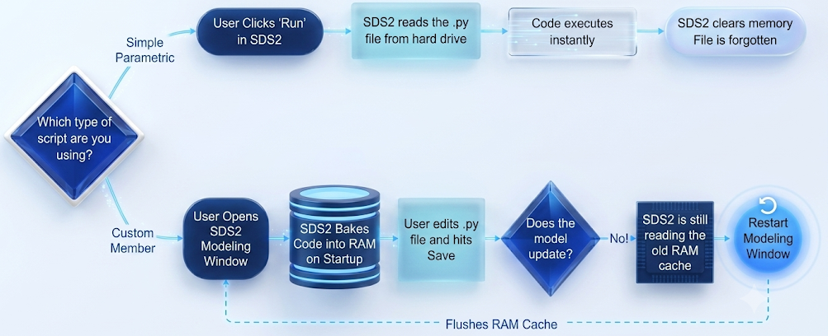
REMEMBER!
Notes:
This was a very frustrating concept that I learned the hard way. Several iterations, before I realized that I needed to close modeling to invoke changes on a plug-in.

Slide 11
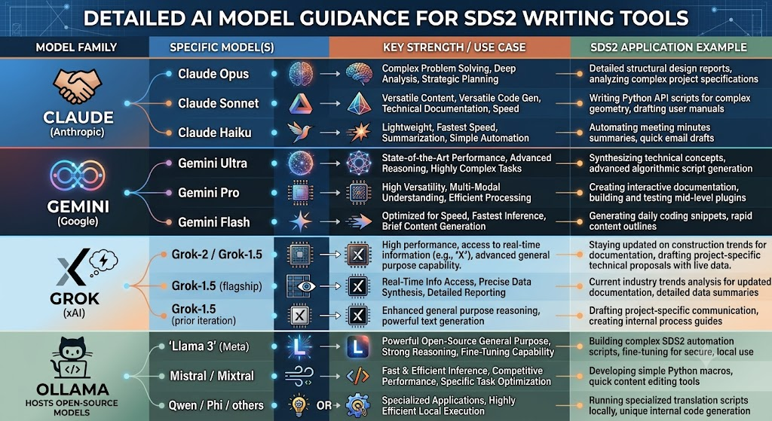
Notes:
There are several tools available, I implore you to give them a try. I tend to go back and forth between Claude and Gemini. I have access to Gemini with my google subscription for my business site, drive, etc. Claude I subscribe to because it is just a little better and it has native plugins for coding software for agentic coding. This business is like cars and power tools. When one comes out with something better, the competition puts something out with just a little more improvement. Figure out what works for you.
In the next year, I hope to be exploring Ollama more indepth and hope to build an LM specific to parametrics and plugins for SDS2.

Slide 12
What tools do I need? How much is this going to cost?
Technically, this could be done with only free tools.
 | Code Editor | LLM
Good | Notepad, Notepad++(Free) | Ollama (Free)
Better | Python Idle 3.xx (Free) | Gemini (Free - $$$)
Best | VSCode, Zed (Free) | Claude, Deepseek*, OpenAI, XAI** ($$-$$$)
*Agentic Coding in VSCode only available via community developed plugins.
**Agentic Coding available through Github Copilot Chat
Notes:
The sky is the limit, but you don’t need to spend money to get started.

Slide 13
Prompting Tips
Be specific
Don’t focus only on what you what, but also what you don’t
Don’t guess – ask questions before writing code
Build and use scrapers and other tools to extract information
Eat it like an elephant
Use more capable models to ideate the infrastructure, then use the worker bees to build the code.
Notes:
Show basic starter prompt:
Developing X for SDS2 using python3 I would like the dialogs to use X, and include sample parametrics.
Don’t steal, don’t plagiarize, give credit where credit is due, and ask permission.
Plan, define steps/path forward, then execute the plan.
Using AI is not free – Personally, I hate the AI slop we’ve all seen on LinkedIn, Facebook, and elsewhere – it’s a waste of a valuable resource and only results in wasting our time and driving the cost of this resource up. At least LinkedIn has created the “seems like AI Slop” button and has effectively reduced the amount we see.
I don’t recommend creating a 3 page prompt explaining EVERY detail and asking AI to generate the code – again – plan, define steps, and execute – one bite at a time.It’s ok to develop the mass framework for placeholders, but build the functionality one step at a time.

Slide 14
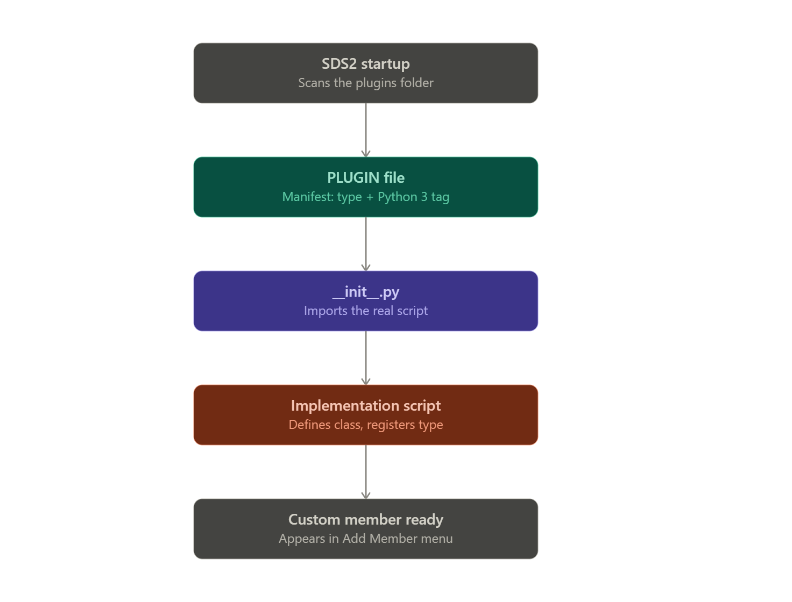
Plugins
PLUGIN (no extension)
_init_.py
Code (one or more files)
Notes:
PLUGIN file – waves it’s arms and says HEY! SDS! OVER HERE! I’M A PLUGIN!
__init__.py gives lightweight code loaded into memory on model startup that tells the software where to go when the user initiates a plugin from within SDS2
Code – the actual code that does the work.

Slide 15
Errors
You are going to cause errors – don’t panic
Build in a sandbox
For plugins – delete and recreate at each iteration

Slide 16
Final Thoughts…
Start small
Look at examples
Take the opportunity to flex your creative muscles
Build in a sandbox
Have fun!

Slide 17
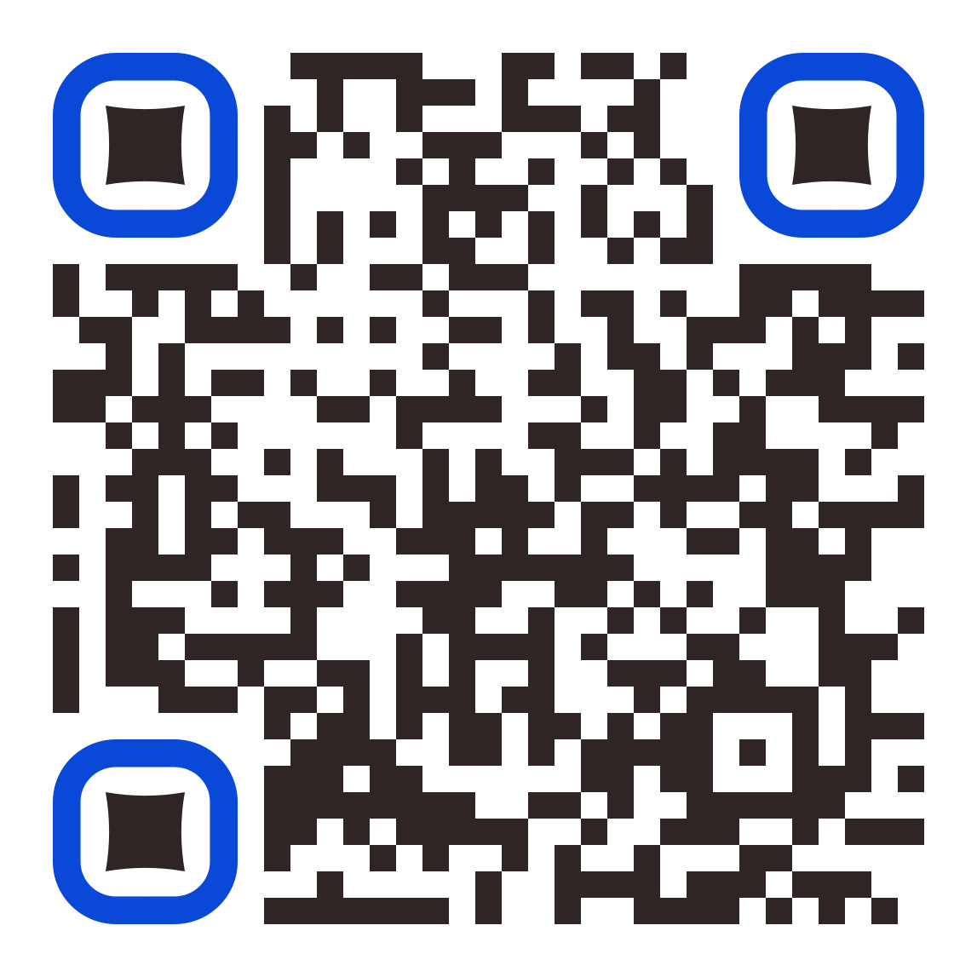
Thank you!
Scan me to go to my Github for access to some of the tools we’ve discussed today!
Jason Bondioli
Bennett Services, LLC

Slide 18
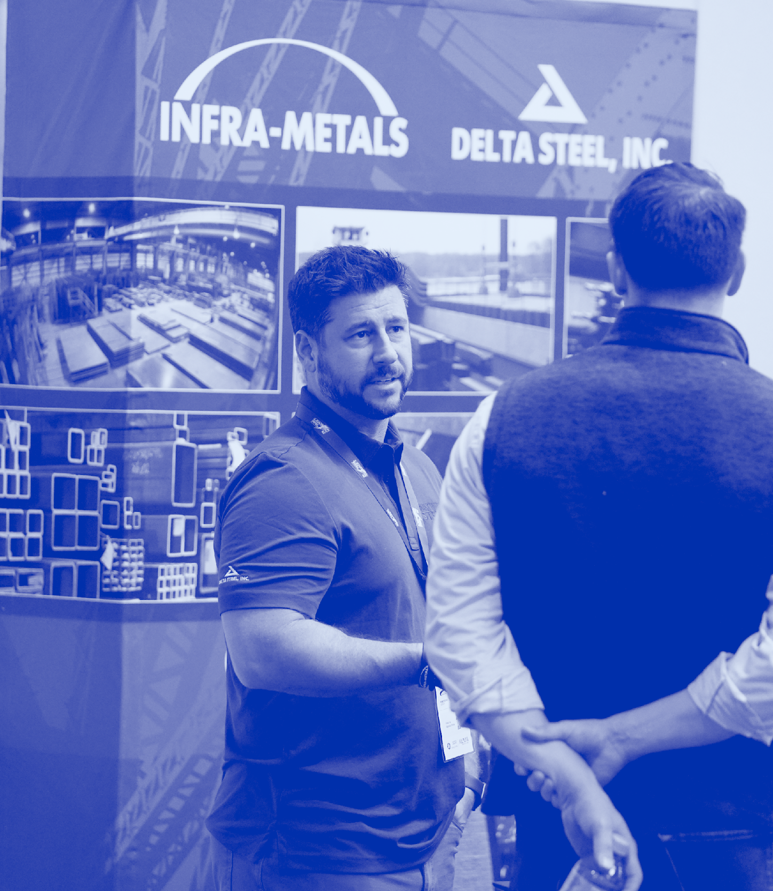
Thank you!
Jason Bondioli
Bennett Services, LLC
https://www.bennettservicesllc.com/services.html

